Slide 1
Bhool Traffic-Improvements
A smart and intelligent traffic monitoring

Slide 2
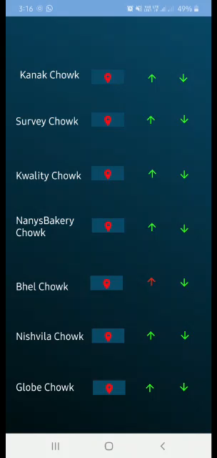
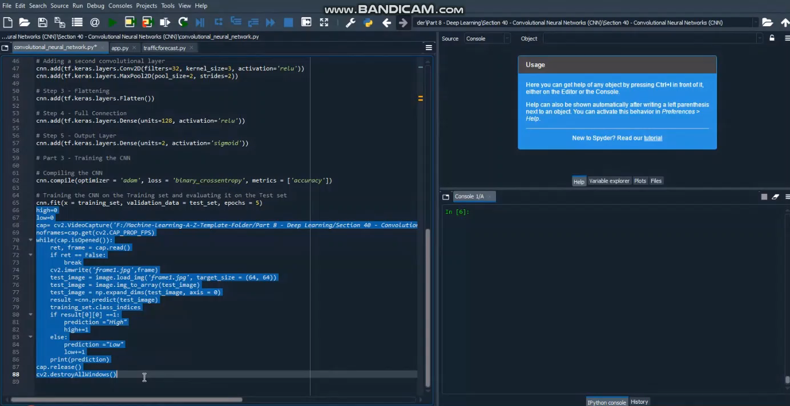
CNN
This is used to update traffic information every 5 minutes in the app graphically
We use a two layered CNN model to predict the traffic using footages obtained from the cctv cameras. Both the layers have activation function ‘Relu’ and output has activation function ‘Sigmoid’. The footage is preprocessed and then classified into low and high traffic.

Slide 3
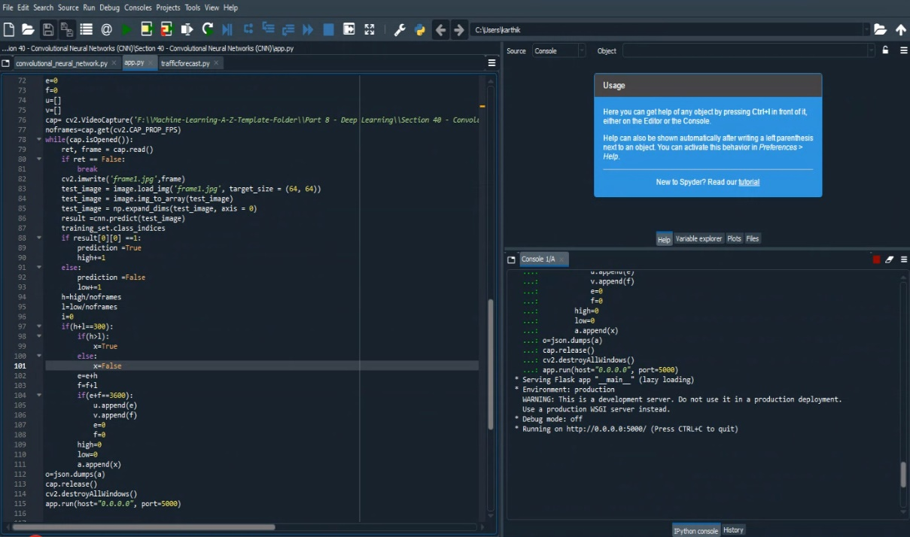
Flask
We needed a backend framework to connect the app with the backend. We chose flask to do the job. The high/low data is dumped into the app in json format. A similar mechanism is followed for traffic forecast also, where prediction is transferred.

Slide 4
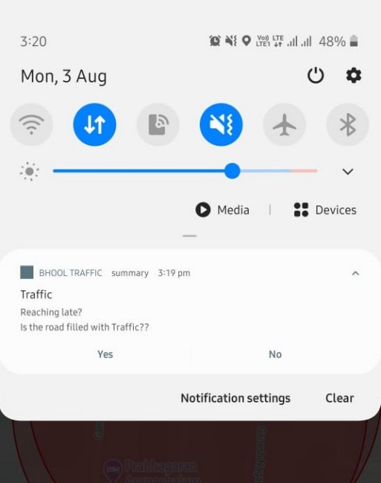
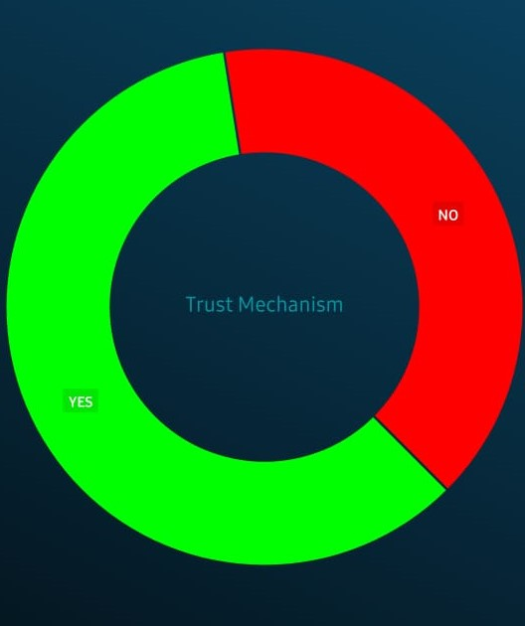
Geofence-Verification
Geofence areas are created, when the user enters a geofence area a notification is sent enquiring about traffic in their location.
The user response is recorded in a database, which is later used to display a graph enabling users to know if our solution actually-works

Slide 5
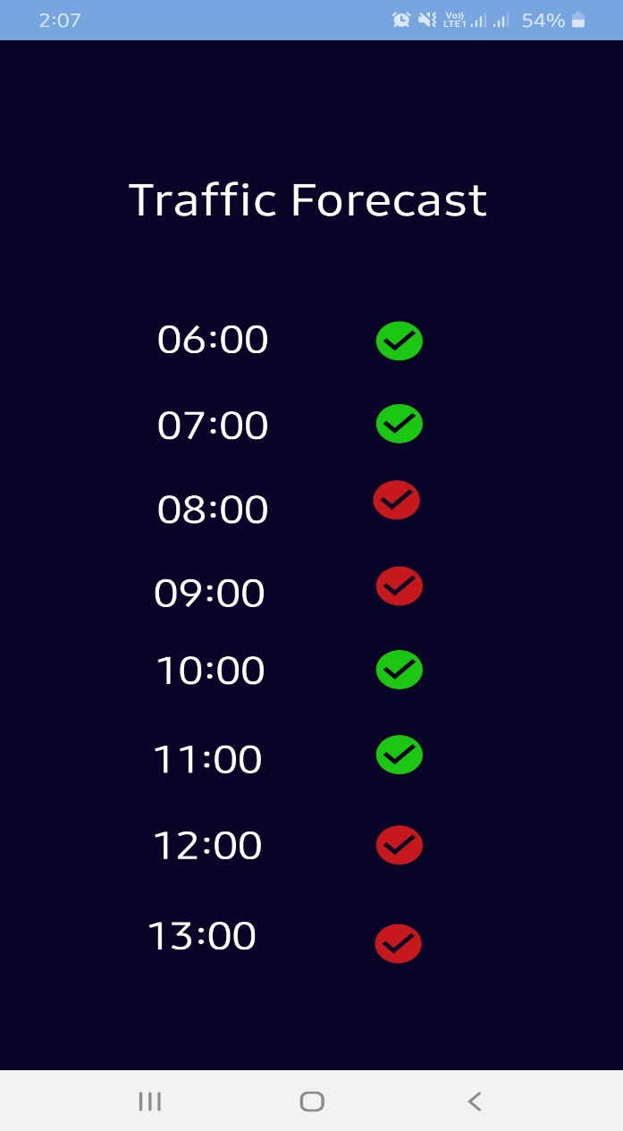
Traffic Forecast
Traffic Forecast shows a general trend so-as-to how the traffic varies in a location for the next day. A Multiple Linear Regression model does this. The high/low data gets stored in a database which is used here.

Slide 6
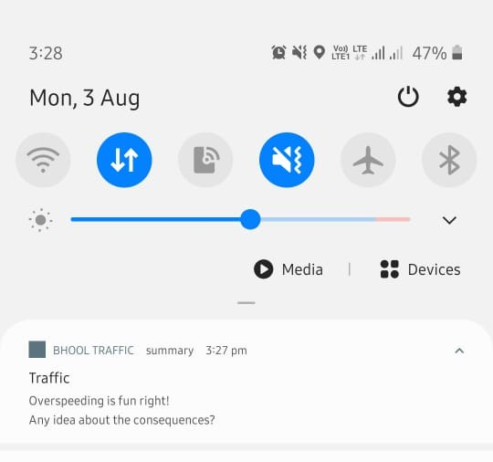
Speed Limit
 | Highway | Intersection
2 wheeler | 50mph | 30mph
4 wheeler | 70mph | 40mph
Heavy Vehicles | 70mph | 30mph
We obtain the location data of users. The change in location and time taken to do so is used to calculate the speed of the vehicle. The speed limit of each road is set by the government.
Comparing these two we conclude if the user over speeded or not. And notifications are sent to bring awareness

Slide 7
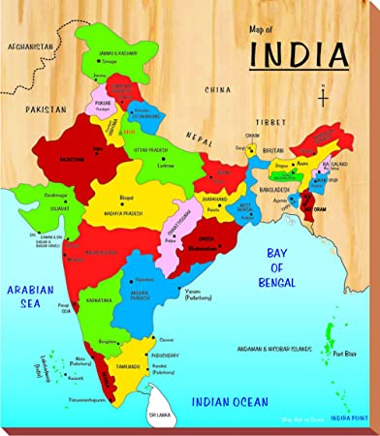
Extending to other cities
Our model can be extended to other cities with two options, one being extending the map alone with high/low data displayed on the map and other is extending the whole app including all pages and features

Slide 8
Thank You

